Slide 1
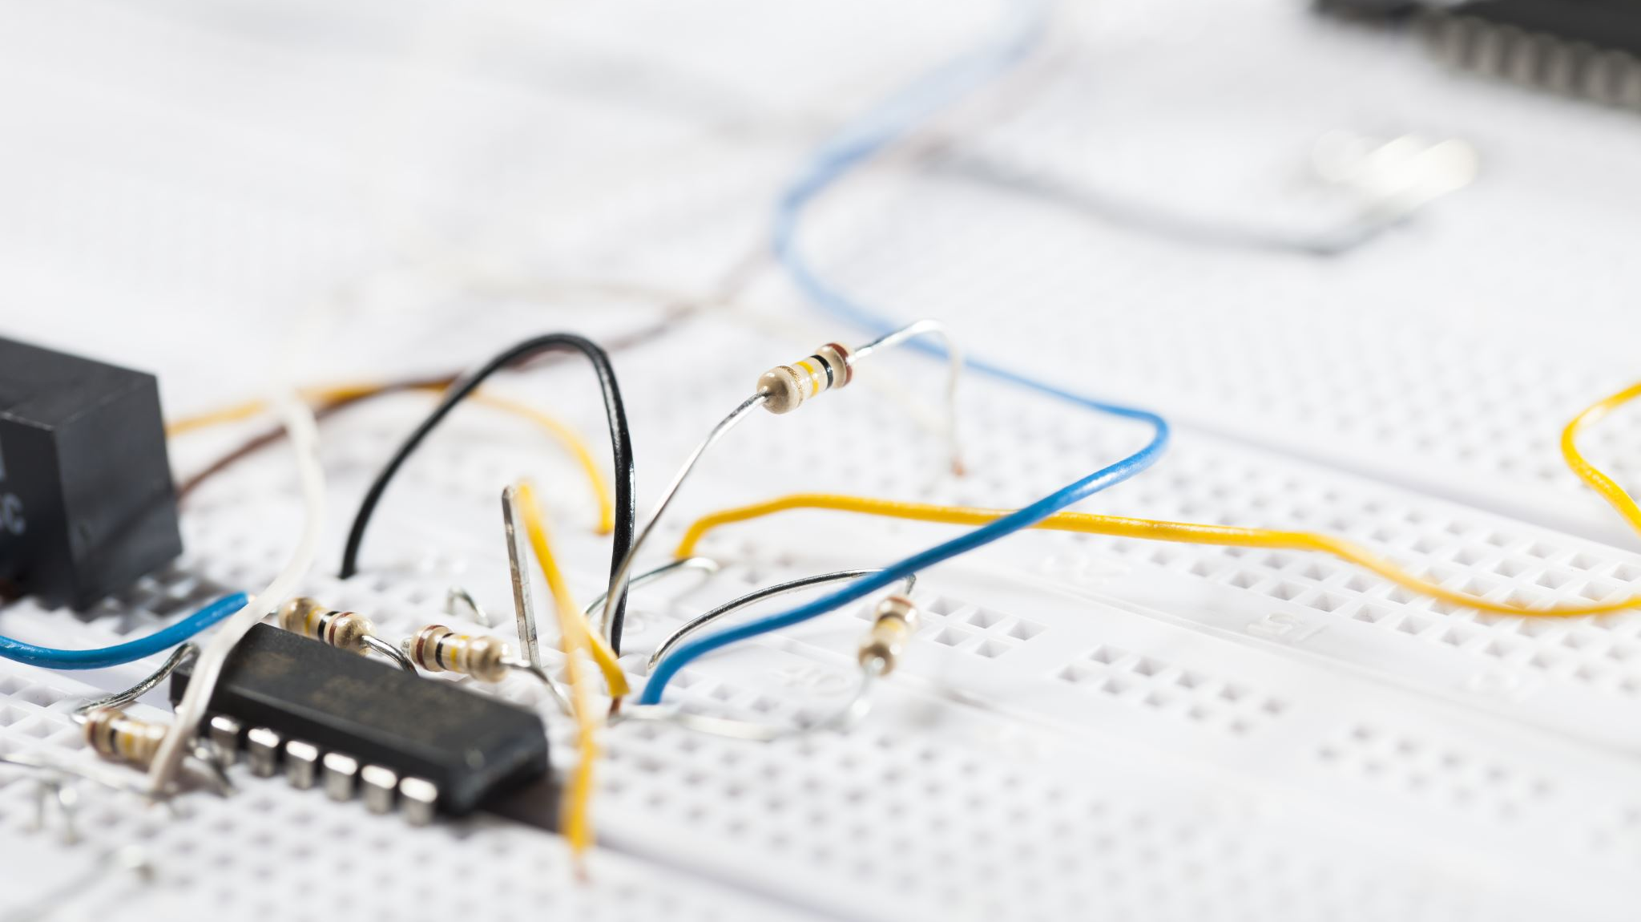
Basic Electronic Theory

Slide 2
Outline
Electronic Signals
Electricity Equations
General Purpose Input / Output (GPIO)
Pulse Width Modulation (PWM)
Analog to Digital Converters (ADC)
Microcontrollers and Computer

Slide 3
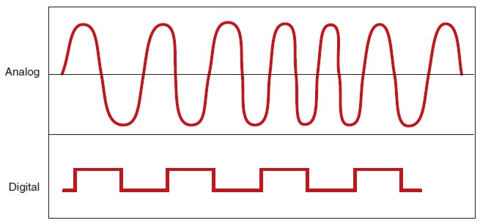
Electronic Signals
Image from http://autosystempro.com/analog-and-digital-principles/

Slide 4
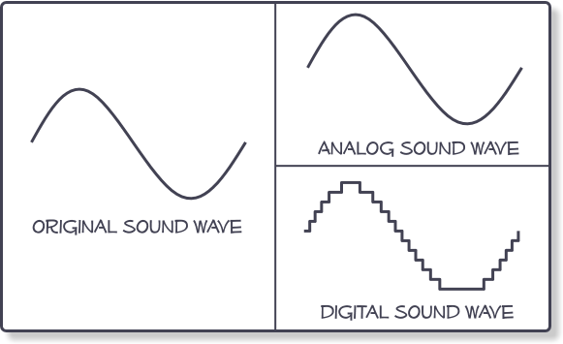

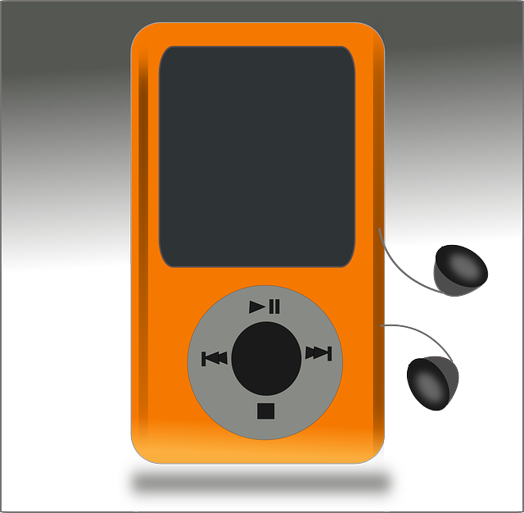
Analog and Digital
Digital devices can only store digital signals
Using 1 or several bits / sample
We store an array of numbers
Parameters
Bits per sample
Sampling rate
Example: Audio…
This Photo by Unknown Author is licensed under CC BY-SA
Image from http://www.centerpointaudio.com/Analog-VS-Digital.aspx

Slide 5
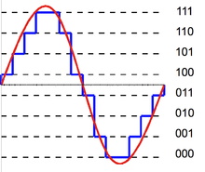
Bits per sample
Using just 1 bit
Just 2 possible values/states: LOW (0) and HIGH (1)
digital
Using >1 bit ( n bits where n>1)
2^{n} possible values/states
Example: using 3 bits:
2³ = 8 possible values/states
Called Quantisation
More bits -> higher resolution -> higher accuracy

Slide 6
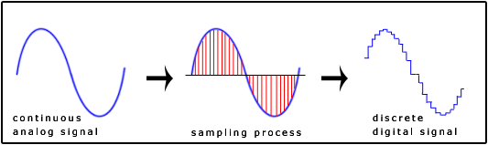
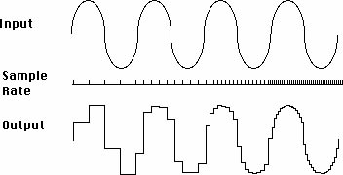
Sampling
Sensor signals are analog
Temp -> voltage -> value
Sampling Rate
Higher sampling rate( frequency) will give higher the accuracy
Image from http://www.snotmonkey.com/work/school/405/overview.html
Image from http://www.jazzpoparkisto.net/audio/audio32.html

Slide 7
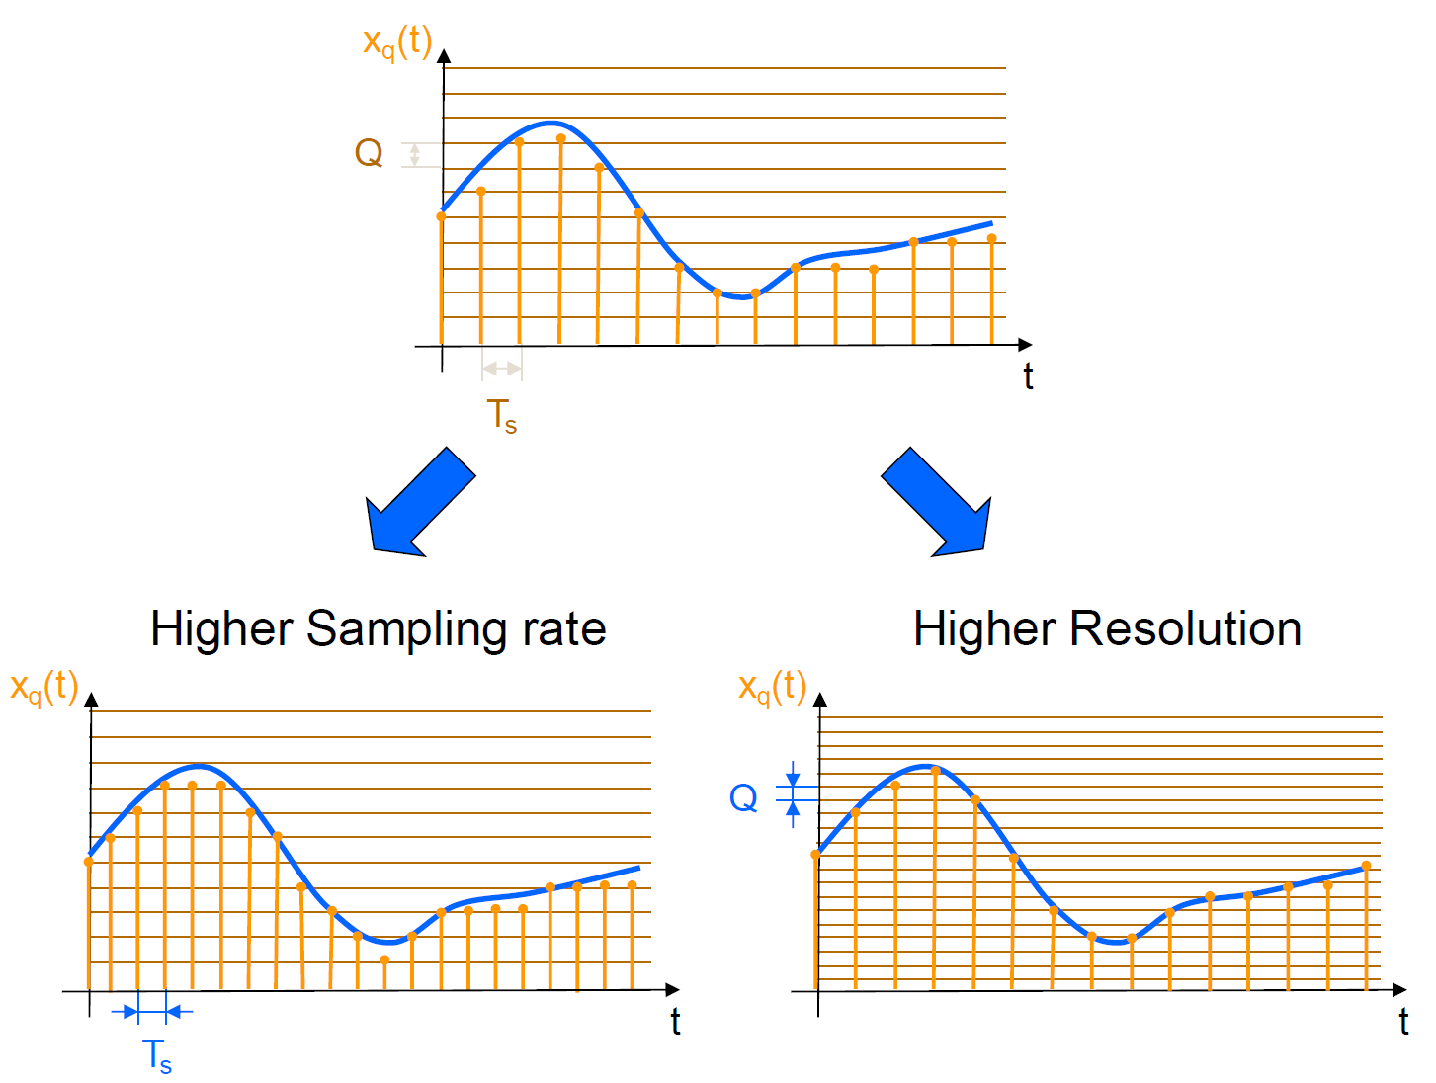

Slide 8
Electricity Equations

Slide 9
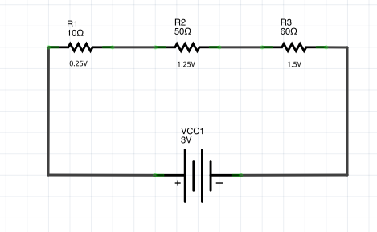
Ohm’s Law

Slide 10
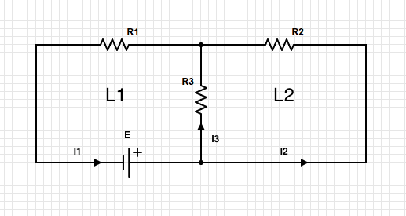
Kirchhoff Law I

Slide 11
Kirchhoff’s Law II

Slide 12
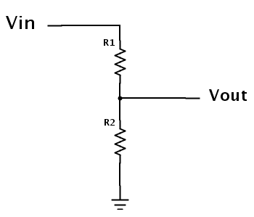

Voltage Divider
If current in ouput wire is 0, then:
$$Vout=\frac{R1}{R1+R2}Vin$$
This Photo by Unknown Author is licensed under CC BY-SA

Slide 13
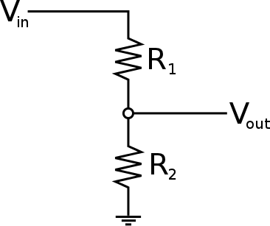

Voltage Divider
$$Vout=\frac{R1}{R1+R2}Vin$$

Slide 14

Voltage Divider
$$Vout=\frac{R1}{R1+R2}Vin$$

Slide 15

Voltage Divider
$$Vout=\frac{R1}{R1+R2}Vin$$

Slide 16
Voltage Divider
$$Vout=\frac{R1}{R1+R2}Vin$$

Slide 17

Voltage Divider
$$Vout=\frac{R1}{R1+R2}Vin$$
SHORT CIRCUIT!

Slide 18
Development Boards

Slide 19
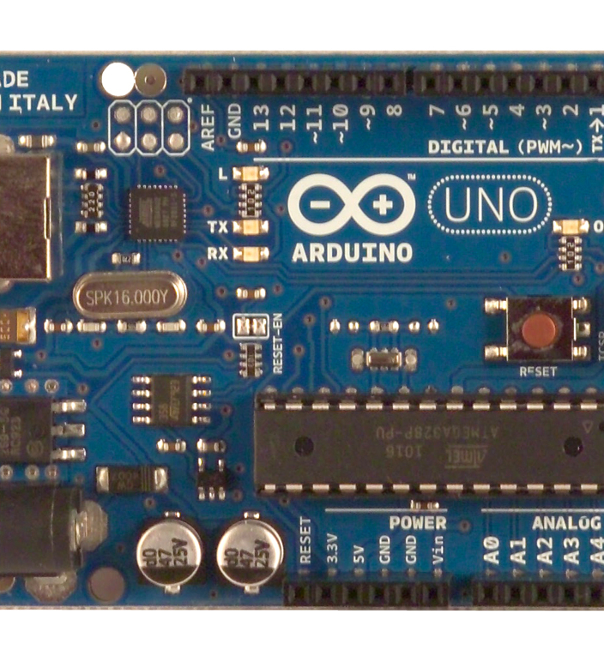
Microcontrollers (e.g. Arduino)
Simple, low cost
Runs one software program
Connect sensors/hardware via GPIO
Constrained Resources
Low speed
small memory
(usually) no disk
No general audio/video/networking (added as needed)
PWM
Can have built in Analog to Digital Conversion.
This Photo by Unknown Author is licensed under CC BY-SA

Slide 20

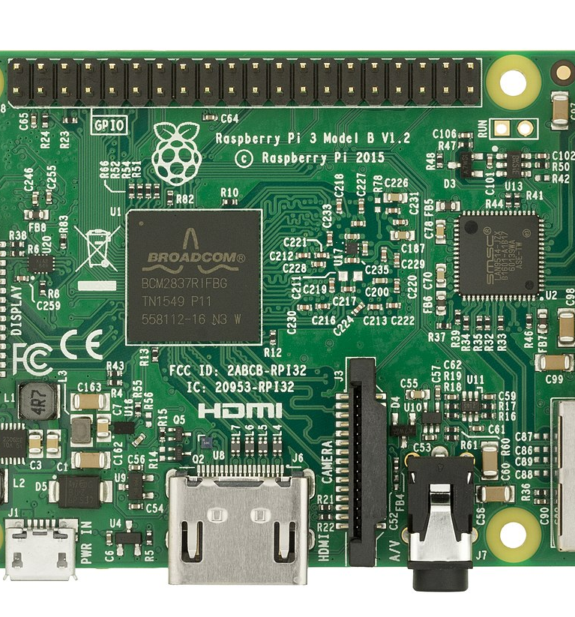
Single Board Computers (e.g. Rpi)
CPU
Memory and Storage
General interfaces for audio/video
Operating System
General Purpose Input and Output
Usually no built in ADC.
This Photo by Unknown Author is licensed under CC BY-SA

Slide 21
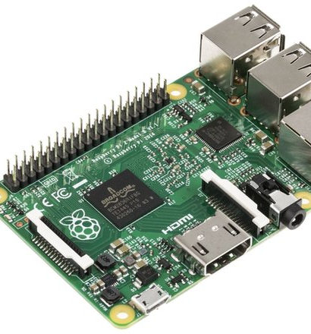
Output and Input on RPi
Digital Pins
Value LOW (0) or HIGH (1)
Write programs to set pins to Low(0) or High(1)
0V or 3.3V
Write programs to read pin values
High(1)
Low(0)

Slide 22
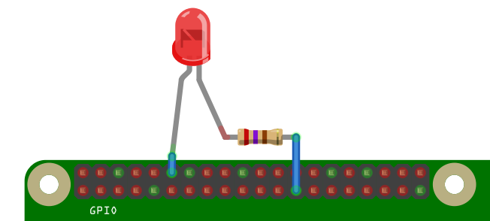
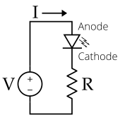
Output
3.3V(HIGH) or 0V(LOW)
Default 8 mA max per pin.
Switching a pin High is like connecting a 3.3V battery to device.
Switching a pin Low is like disconnecting the battery
This Photo by Unknown Author is licensed under CC BY-SA

Slide 23
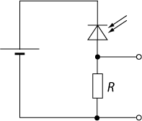
Input
Can be Voltage Divider Circuit
Can measure Vout…
via analogue input on Arduino
Required Analog to Digital converter on RPi. (unless you want it to act like a switch)
This Photo by Unknown Author is licensed under CC BY-SA

Slide 24
Pulse With Modulation

Slide 25
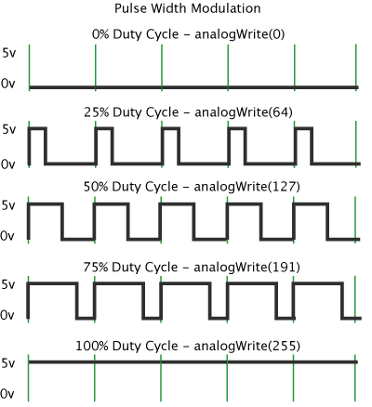
Pulse Width
We set the % of “high” cycle
0 – 0%
255 – 100%
Depends on the library
Implementation
Hardware
Software
Usage
LED dimming
Servo Motors

Slide 26
Analog to Digital Converters

Slide 27
Analog and Digital Converters
Measure voltage
Parameters
Bits per sample
Sampling rate
For 1 bit we have …
Image from http://www.centerpointaudio.com/Analog-VS-Digital.aspx

Slide 28
Analog and Digital Converters
Measure voltage
Parameters
Bits per sample
Sampling rate
For 1 bit we have …
GPIO Input
Image from http://www.centerpointaudio.com/Analog-VS-Digital.aspx

Slide 29
Analog and Digital Converters
Measure voltage
Parameters
Bits per sample
Sampling rate
For 1 bit we have …
GPIO Input
Image from http://www.centerpointaudio.com/Analog-VS-Digital.aspx

Slide 30
Analog and Digital Converters
Measure voltage
Parameters
Bits per sample
Sampling rate
For 1 bit we have …
GPIO Input
For n bits we have …
Image from http://www.centerpointaudio.com/Analog-VS-Digital.aspx

Slide 31
Analog and Digital Converters
Measure voltage
Parameters
Bits per sample
Sampling rate
For 1 bit we have …
GPIO Input
For n bits we have …
0 – 2^{n}-1
Image from http://www.centerpointaudio.com/Analog-VS-Digital.aspx

Slide 32
Microcontrollers and Computers

Slide 33
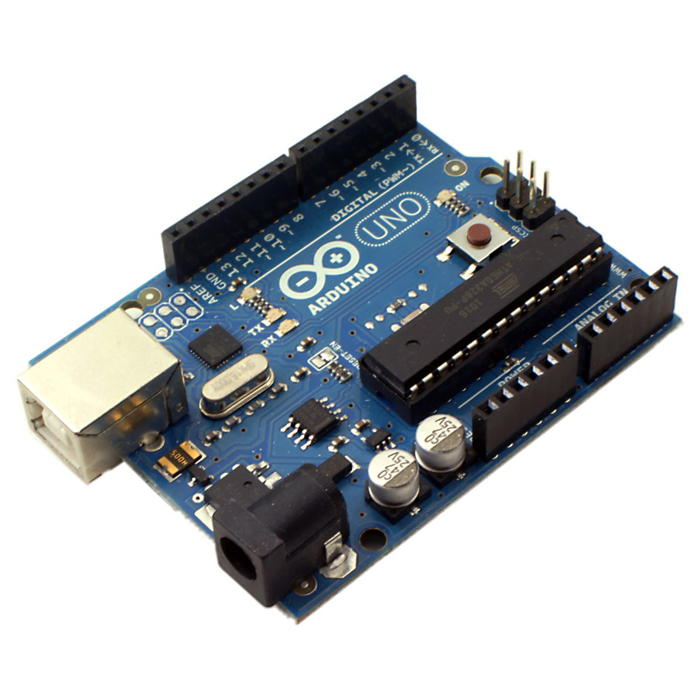
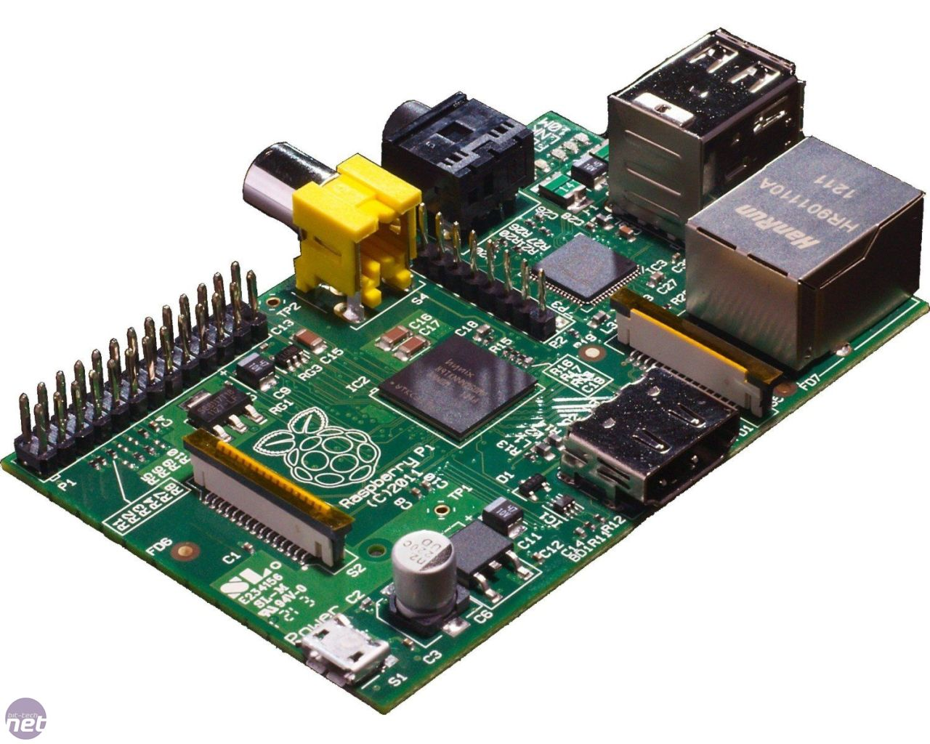
Microcontrollers and computers
Firmware
Software

